Slide 1
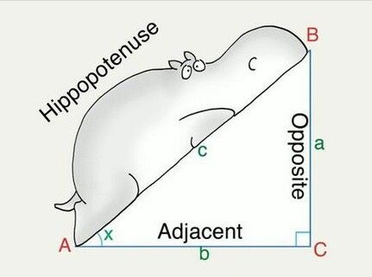
Geometry REVISION: Pythagoras Theorem and Trigonometry
LI: Learn how Pythagoras theorem can be applied to right triangles.

Slide 2

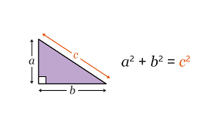
What is Pythagoras theorem…. See above.
Lets dive straight into solving problem.
Find the value of C???

Slide 3
Pythagoras theorem applies to right triangles only? Can you find any right triangles and calculate the diagonal length of following square and rectangle?
  What about the below ?
  10cm 15cm
  10 cm 10cm

Slide 4
Pythagoras theorem applies to right triangles only? Can you find any right triangles and calculate the diagonal length of following square and rectangle?
  Can we see the two right triangles?
  10cm 15cm
  10 cm 10cm

Slide 5


SOH CAH TOA
Question: What is SOH CAH TOA?

Slide 6
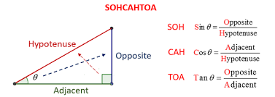

Slide 7

Why do we need these
formulas????
Please write down at least one
Reason.

Slide 8
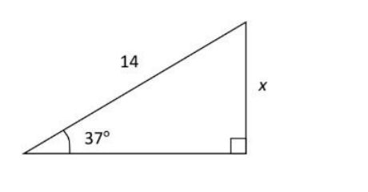
Can it be used to find the missing length?

Slide 9
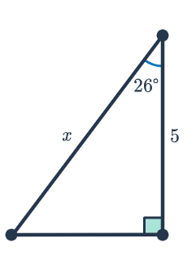

Lets try another this time with missing hypotenuse

